Slide 1

High Impact Skills Development Program
in Artificial Intelligence, Data Science, and Blockchain
Module 8: Object Detection & Recognition Using CNN
Lecture 3: Introduction to Object Detection and Techniques
Instructor: Ahsan Jalal

Slide 2
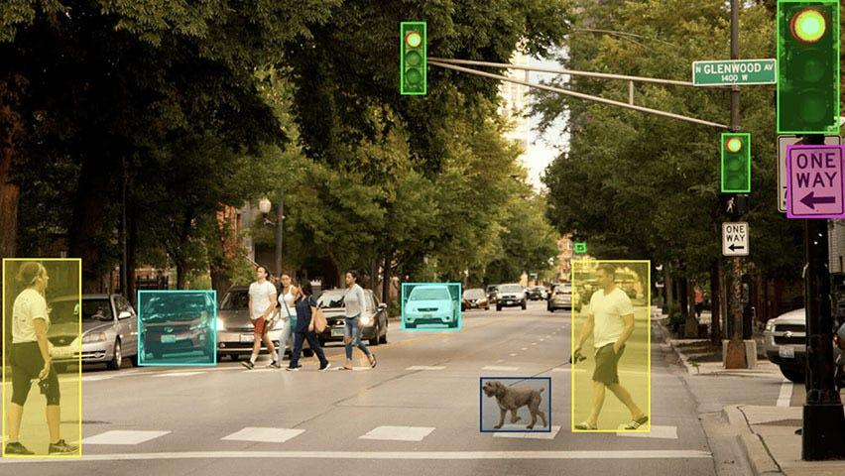
What is Object Detection?
Object detection is the process of identifying and locating objects in an image or video.
Classify objects and draw bounding boxes around them.

Slide 3

Object Detection vs. Classification
Classification: Predicts the object class in an entire image.
Object Detection: Predicts both the object class and its location within an image.

Slide 4
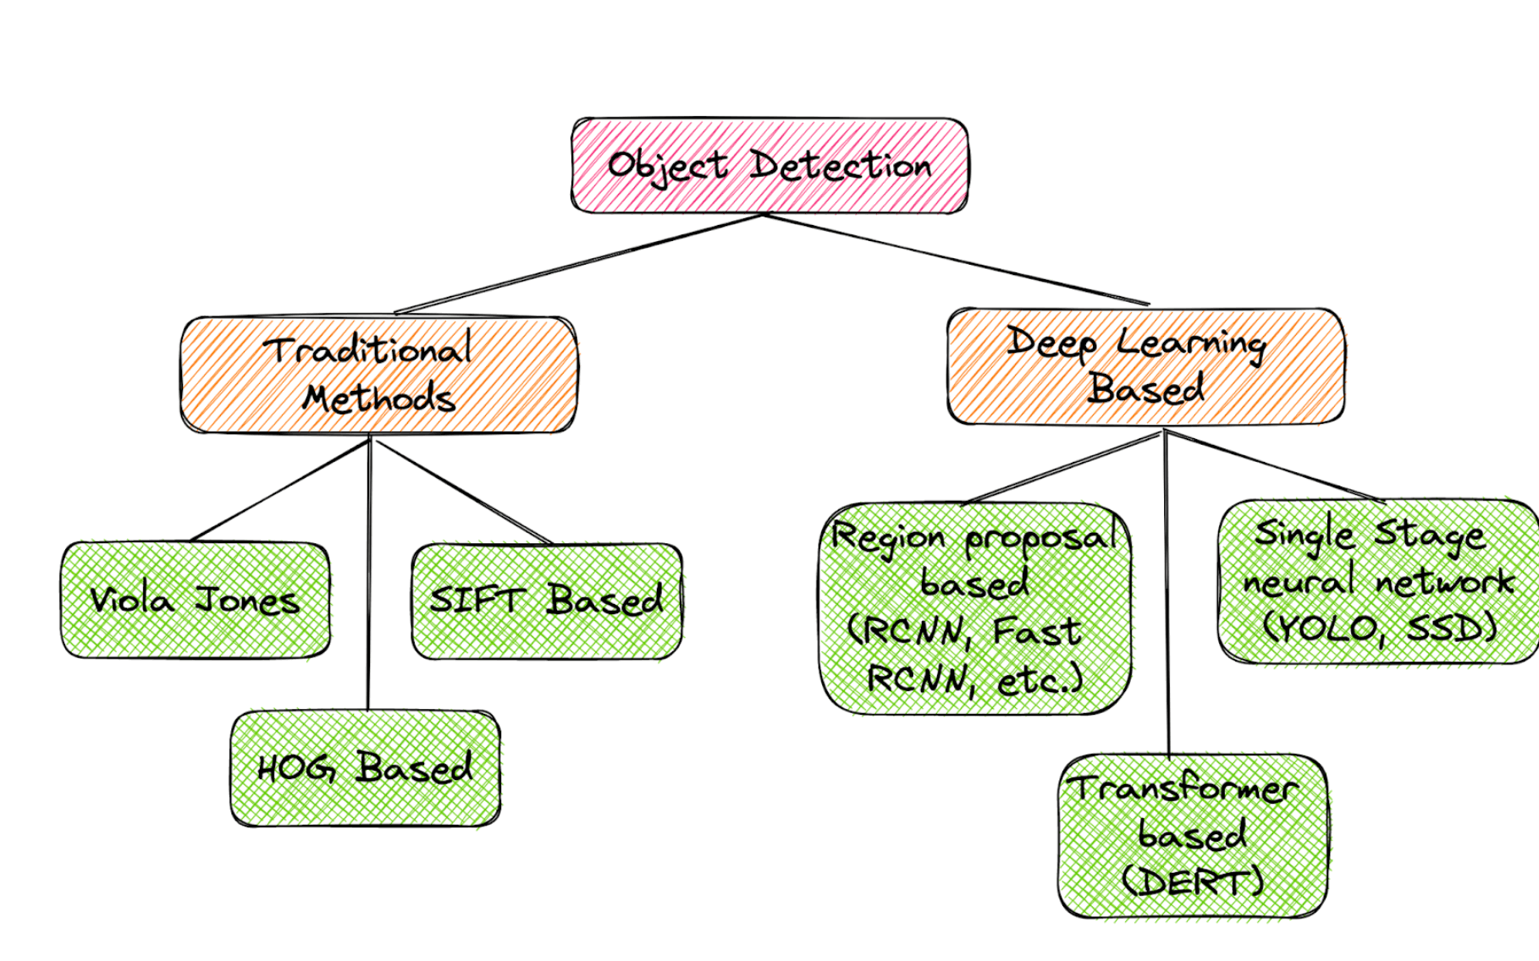
The Evolution of Object Detection Architectures
Early Approaches:
Sliding Window Method: Manually crop windows at different scales and classify each.
Handcrafted Features: SIFT, HOG (Histogram of Oriented Gradients).
Modern Approaches:
Deep learning models that automate feature extraction and object localization.

Slide 5
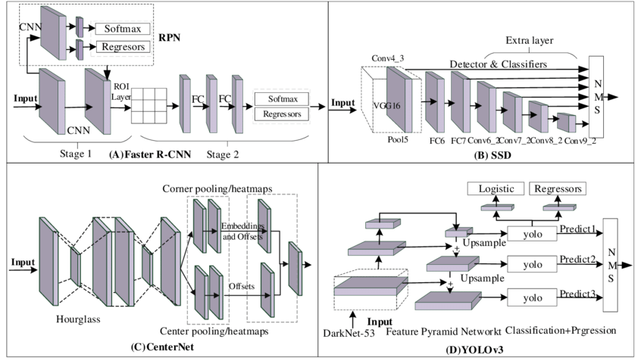
Types of Object Detection Architectures
Two-Stage Detectors
Region Proposal + Classification
Example: R-CNN, Fast R-CNN, Faster R-CNN.
Single-Stage Detectors
Directly predict bounding boxes and classes.
Example: YOLO, SSD, RetinaNet.

Slide 6
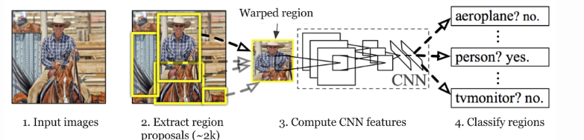
What is R-CNN
R-CNN (Region-based Convolutional Neural Networks) is the first deep learning-based object detection method that combines region proposal techniques with CNN-based feature extraction.
Use selective search to generate region proposals, then classify each region using a CNN.

Slide 7
R-CNN Pipeline
Region Proposal (Selective Search):
Generates around 2000 candidate region proposals using selective search
CNN-based Feature Extraction:
Each region proposal is resized to a fixed size and passed through a CNN (e.g., AlexNet) to extract features.
Classification:
The extracted features are classified using a linear SVM.
Bounding Box Regression:
Fine-tune the bounding box locations to improve localization accuracy.

Slide 8
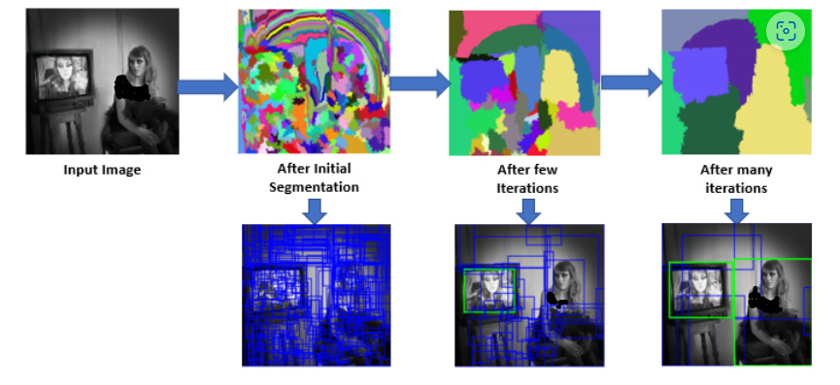
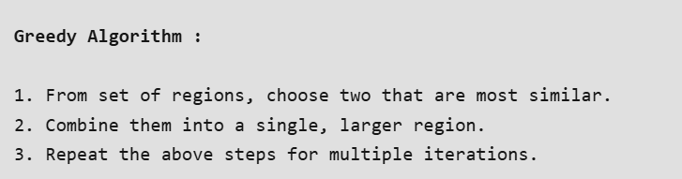
R-CNN: Region Proposal
A method that groups similar pixels into candidate regions based on color, texture, size, and shape.
To reduce the region proposals in the R-CNN uses a greedy algorithm called selective search.
Similarities are considered based on color similarity, texture similarity, region size, etc.
Pros: Reduces the number of regions to be processed by the CNN.
Cons: Still relatively slow and heuristic-based.

Slide 9
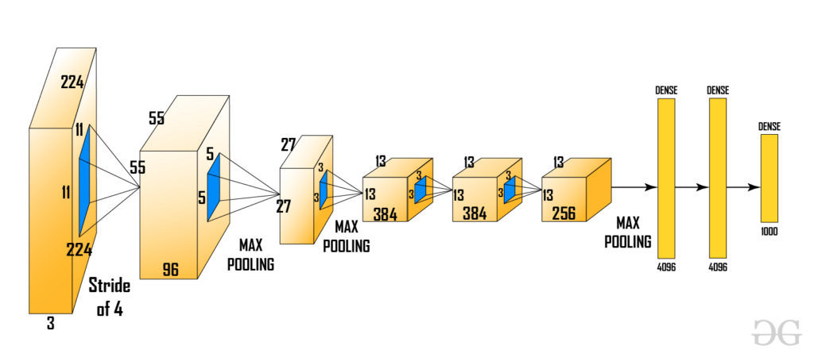
R-CNN:CNN-based Feature Extraction & Classification
Each region is cropped and resized to a fixed size (e.g., 227x227 for AlexNet) and passed through a CNN to extract high-level features.
The last softmax layer is removed to get the (1, 4096) feature vector.
This feature vector is then passed to SVM and bounding box regressor.

Slide 10
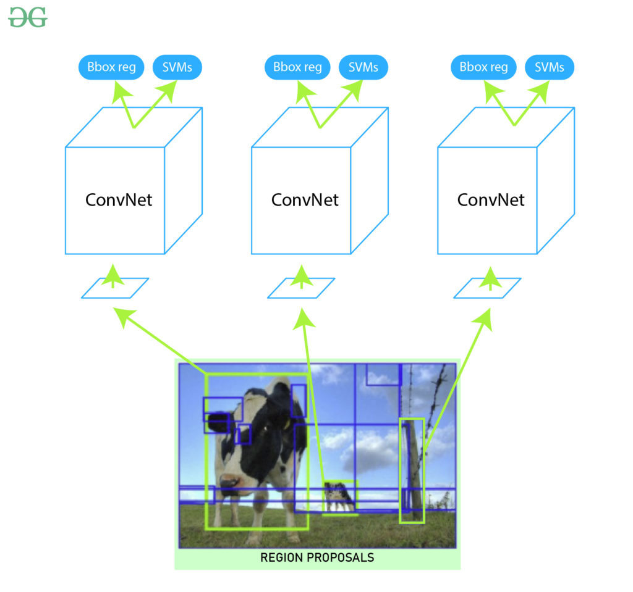
R-CNN: Bounding Box Regression
Initial bounding boxes proposed by selective search are not perfectly aligned with objects.
Use bounding box regression to refine the location and size of the bounding box for better alignment.
Four dimensions of localization (x,y,w,h) from predicted and Ground Truth are used to train the model.
These dimensions are center coordinates (x,y), width (w) and height(h) of the box.
This method has improved Mean Average Precision (mAP) of the result by 3-4%

Slide 11
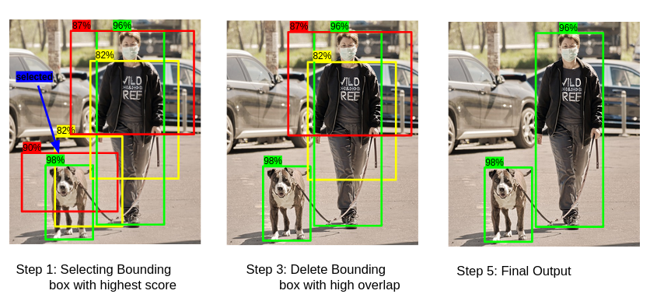
R-CNN: Bounding Box Regression
The algorithm Non-maximum suppression (NMS) is used to reduce the number of redundant detections generated.
Suppress detections that have low confidence or overlap significantly with higher-confidence detections.

Slide 12
Challenges of R-CNN
Pros:
R-CNN significantly improved object detection accuracy compared to earlier methods.
CNNs provided more robust feature representations compared to traditional methods.
Cons:
The selective Search algorithm is very rigid and there is no learning
This sometimes leads to bad region proposal generation for object detection.
It takes a lot of time to train multiple steps separately (CNN architecture, SVM model, bounding box regressor).
R-CNN can not be used in real-time because it takes approximately 50 sec to test an image with a bounding box regressor.
Since we need to save feature maps of all the region proposals. It also increases the amount of disk memory required during training.

Slide 13
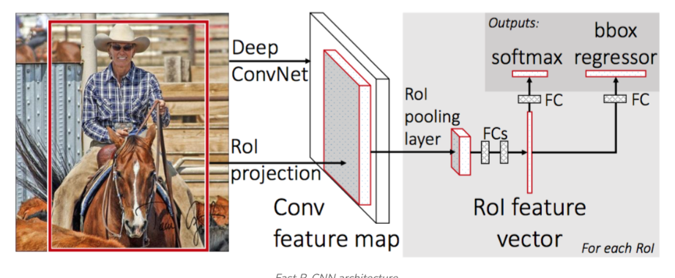
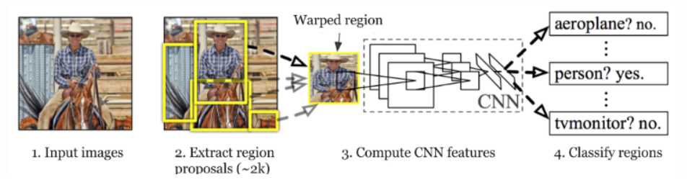
What is Fast R-CNN?
An improvement over R-CNN that significantly reduces the inference time.
Key Goals:
Speed: Share the computation for feature extraction across regions.
Accuracy: Maintain or improve detection accuracy.
End-to-End Training: Train the entire network in a single step.
Fast R-CNN
R-CNN

Slide 14
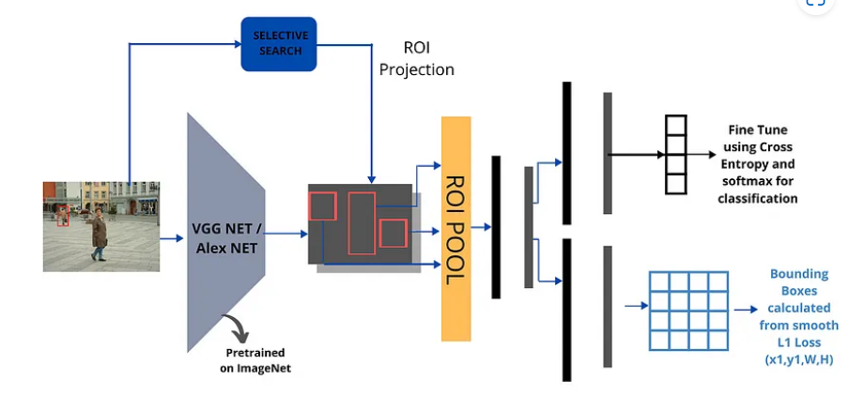
Fast R-CNN Architecture Overview
Input: Entire image (not individual regions).
Selective search to get region proposals on the image.
Feature Extraction: A single forward pass through the CNN for the whole image.
Region of Interest (RoI) Pooling:
Extracts fixed-size feature maps for each region proposal from the feature map generated by the CNN
Classification & Bounding Box Regression:
For each RoI, predict the object class and refine the bounding box.
Fast R-CNN

Slide 15
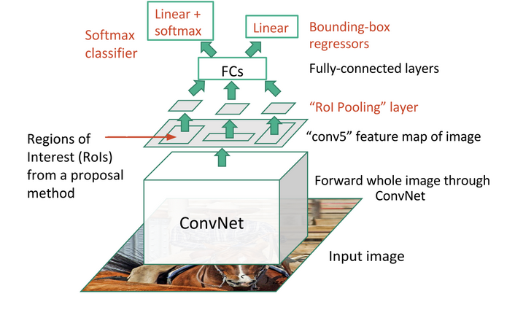
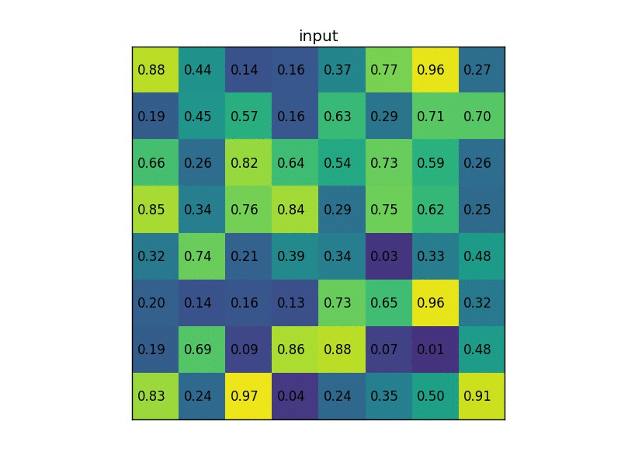
Fast R-CNN: RoI Pooling
Converts regions of different sizes from the feature map into fixed-size feature maps (e.g., 7x7).
Each region is divided into a grid of fixed dimensions.
Max-pooling is performed within each grid cell to ensure the output has a uniform size.
Advantage: Enables the use of fully connected layers on variable-sized regions.

Slide 16
Fast R-CNN: End-to-End Training
Fast R-CNN combines classification and bounding box regression in a multi-task loss function.
Softmax over object classes confidence
Smooth L1 loss for refining bounding boxes.
Train the entire network (feature extractor, RoI pooling, classifier, and regressor) in one go.

Slide 17
Fast R-CNN: Pros and Cons
Pros:
Speed: Faster due to single CNN pass for feature extraction.
Memory Efficient: Avoids feature caching.
End-to-End Training: Simpler and more efficient training process.
Cons:
Region Proposal Bottleneck: Still uses Selective Search for region proposals, which remains slow.

Slide 18
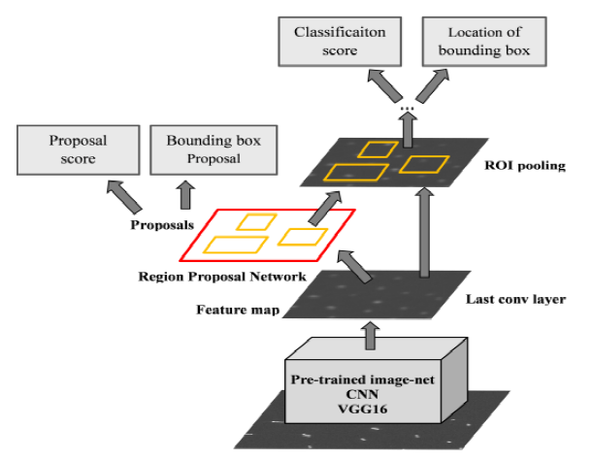
What is Faster R-CNN
An upgrade to Fast R-CNN
Integrates Region Proposal Network (RPN) directly into the architecture.
Replaces Selective Search with a trainable, fully convolutional network for generating region proposals.
Key Contributions:
Reduces time by making region proposals part of the network.
Entire model (including region proposals) can be trained together.

Slide 19
Faster R-CNN Architecture Overview
Backbone Network: Feature extraction from the entire image using a CNN (e.g., VGG16 or ResNet).
Region Proposal Network (RPN): A small, fully convolutional network that predicts object proposals (bounding boxes) at multiple scales and aspect ratios.
RoI Pooling: Converts variable-sized proposals into fixed-size feature maps for classification and bounding box regression.
Head Network: Classifies each RoI and refines its bounding box.

Slide 20
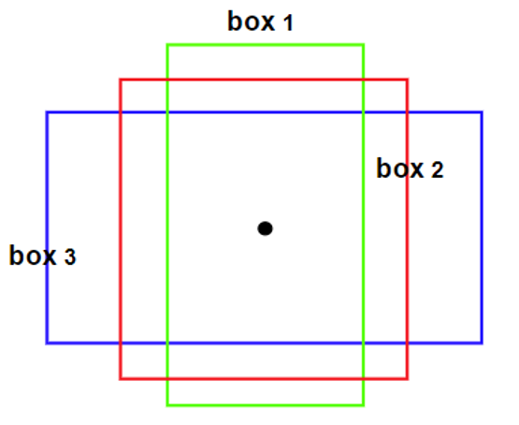
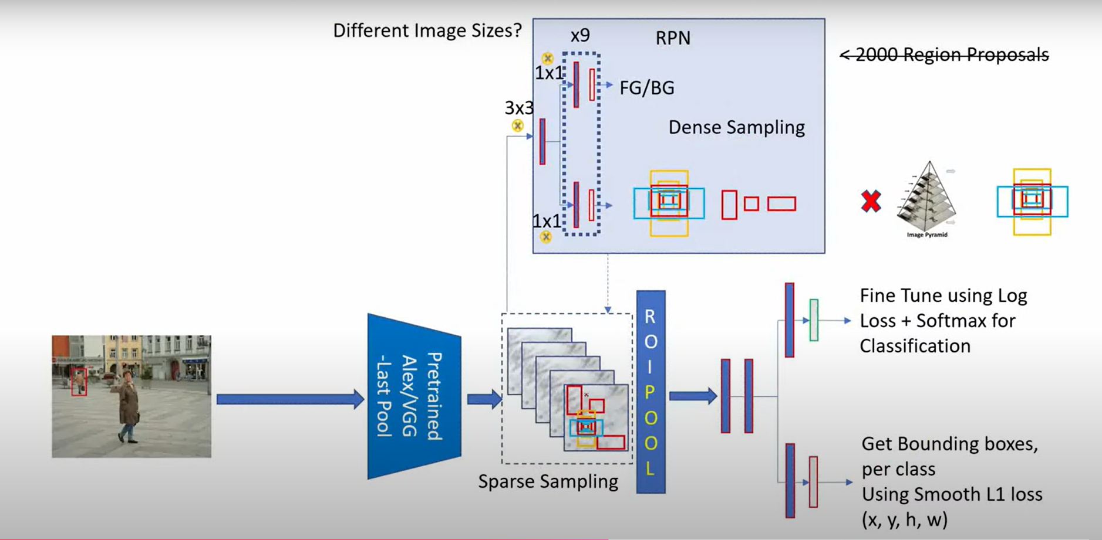
Region Proposal Network (RPN)
Generates object proposals (regions likely containing objects) directly from the shared feature map.
Sliding window approach over the feature map.
For each sliding window operation on anchor boxes, the RPN predicts:
Objectness score: Whether the region contains an object or not.
Bounding box coordinates: Location of the object.
Anchor boxes have different scales (e.g., 128, 256, 512 pixels) and ratios (e.g., 1:1, 2:1, 1:2)
Notes:
Why anchors:Objects vary in size and aspect ratio, so anchors handle multiple scales and shapes.
At each position in the feature map, anchors predict potential object locations.
The RPN adjusts these anchors to fit the actual objects.
The bounding box regressor predicts adjustments to anchors based on the feature map.

Slide 21
Key Improvements Over Fast R-CNN
Integrated Region Proposal Network:
Replaces slow Selective Search with a fast, trainable network.
Speed:
Significant improvement in inference time.
Allows for faster processing of images while maintaining high detection accuracy.
End-to-End Training:
The RPN and object detection stages are trained jointly, optimizing both tasks simultaneously.
Aspect | R-CNN | Fast R-CNN | Faster R-CNN
Publication Year | 2014 | 2015 | 2015
Region Proposal Method | Selective Search (External Algorithm) | Selective Search (External Algorithm) | Region Proposal Network (RPN) (Integrated)
Feature Extraction | CNN on each region proposal | Single CNN on the entire image | Single CNN on the entire image
Classification | SVM classifier on extracted features | Softmax layer in CNN | Softmax layer in CNN
Bounding Box Regression | Separate linear regressor | Integrated in the network | Integrated in the network
Speed | Slow (takes around 47s per image) | Faster than R-CNN (2s per image) | Much faster (0.2s per image)
Pros | Pioneering approach using deep learning | Improved speed and simpler training | Integrated proposal generation, much faster
Cons | Slow, multi-stage, requires lots of storage | Still relies on slow Selective Search | Complex RPN but highly efficient

Slide 22
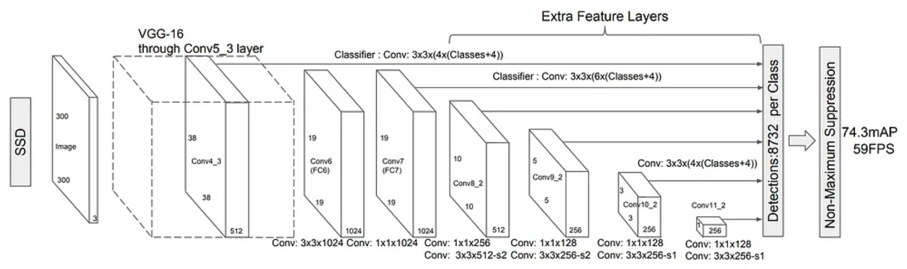
Introduction to SSD
SSD stands for Single Shot MultiBox Detector.
Both object localization and classification are performed in a single pass.
SSD uses feature maps at multiple scales for detecting objects of different sizes.
Multiple default bounding boxes (8732 anchors) of different aspect ratios are used at each feature map location.
Faster than region proposal-based methods like Faster R-CNN

Slide 23
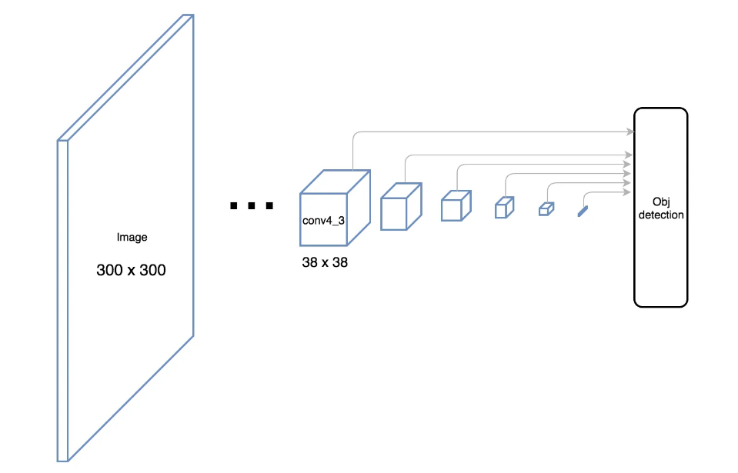
SSD: Architecture
Base Network: Typically uses a backbone CNN like VGG16 or ResNet.
Extra Layers: Adds convolutional layers after the base network to handle detection at different scales.
Feature Maps: SSD makes predictions from multiple feature maps of different sizes (e.g., 38x38, 19x19, 10x10).

Slide 24
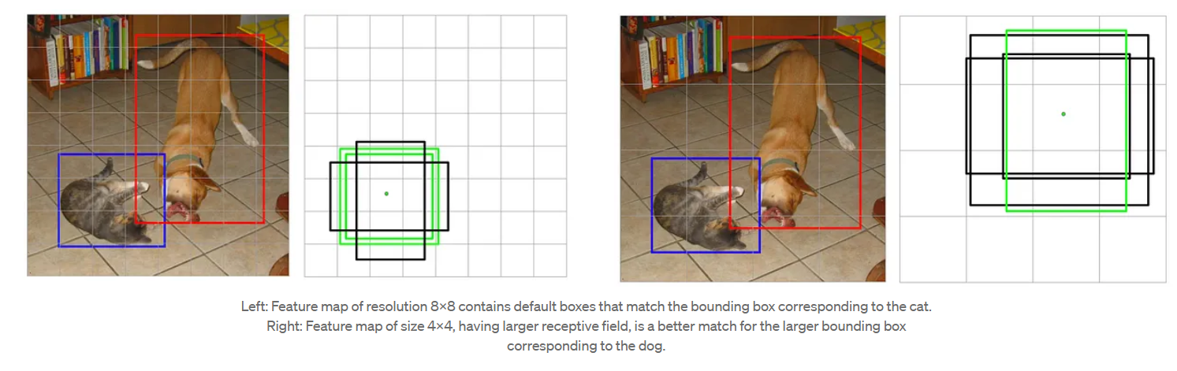
SSD: Architecture
Base Network: Typically uses a backbone CNN like VGG16 or ResNet.
Extra Layers: Adds convolutional layers after the base network to handle detection at different scales.
Feature Maps: SSD makes predictions from multiple feature maps of different sizes (e.g., 38x38, 19x19, 10x10).
Large objects are detected from coarse feature maps (smaller dimensions).
Small objects are detected from fine feature maps (larger dimensions).
Predefined anchor boxes (8732 default boxes) of different scales and aspect ratios are used
Each feature map cell predicts offsets (Δx, Δy, Δw, Δh) for fine-tuning the box coordinates.

Slide 25
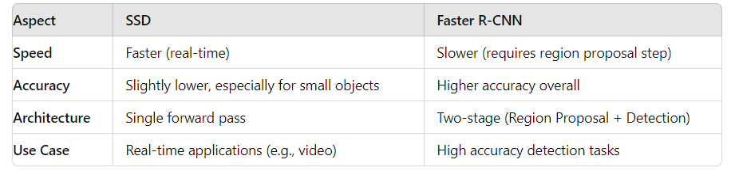
SSD: Architecture
SSD uses Non-Maximum Suppression (NMS) to remove redundant detections.
NMS helps in selecting the best bounding box for each detected object based on confidence scores.
Advantages of SSD
Real-time Performance: Fast inference makes SSD suitable for real-time applications.
Single Network: End-to-end training without requiring a separate region proposal network.
Multiple Object Scales: Efficiently handles objects of different sizes in a single image.
Disadvantages of SSD
Lower Accuracy for Small Objects: Since SSD relies on lower-resolution feature maps for detecting smaller objects, accuracy can be affected.
Requires Careful Design of Anchor Boxes: Proper tuning of anchor boxes is crucial for optimal performance.

Slide 26
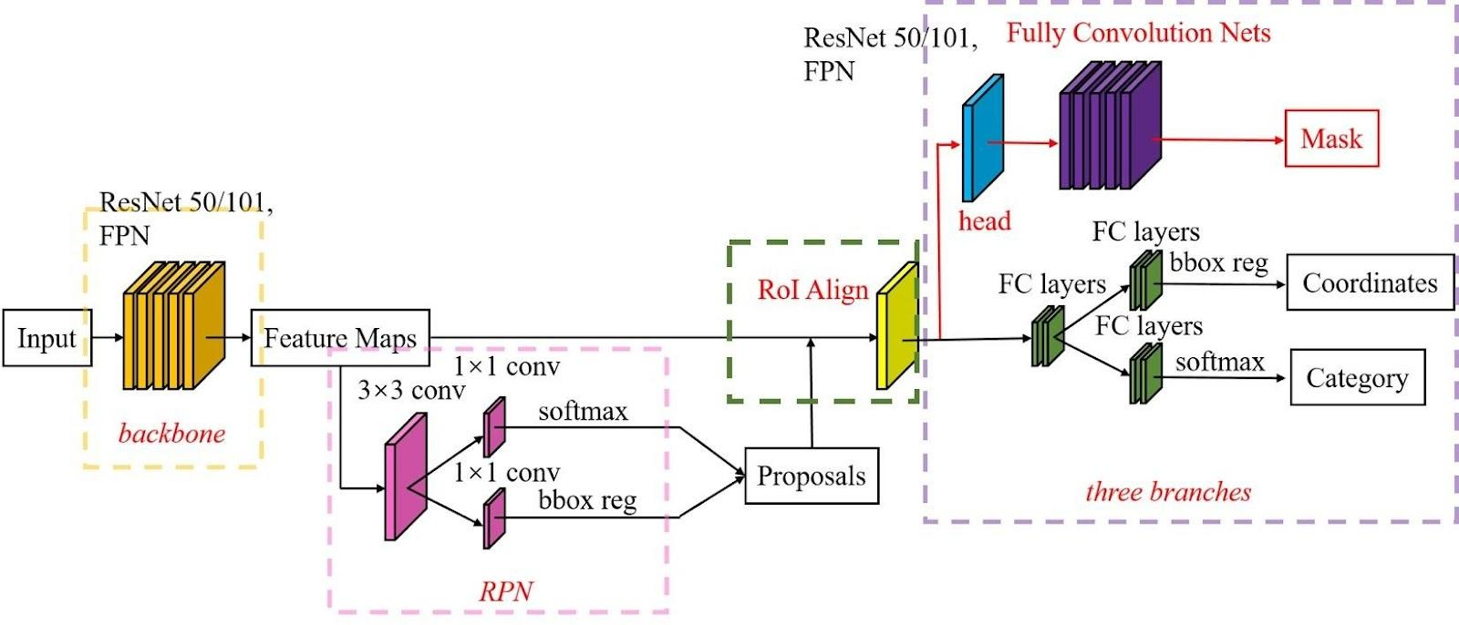
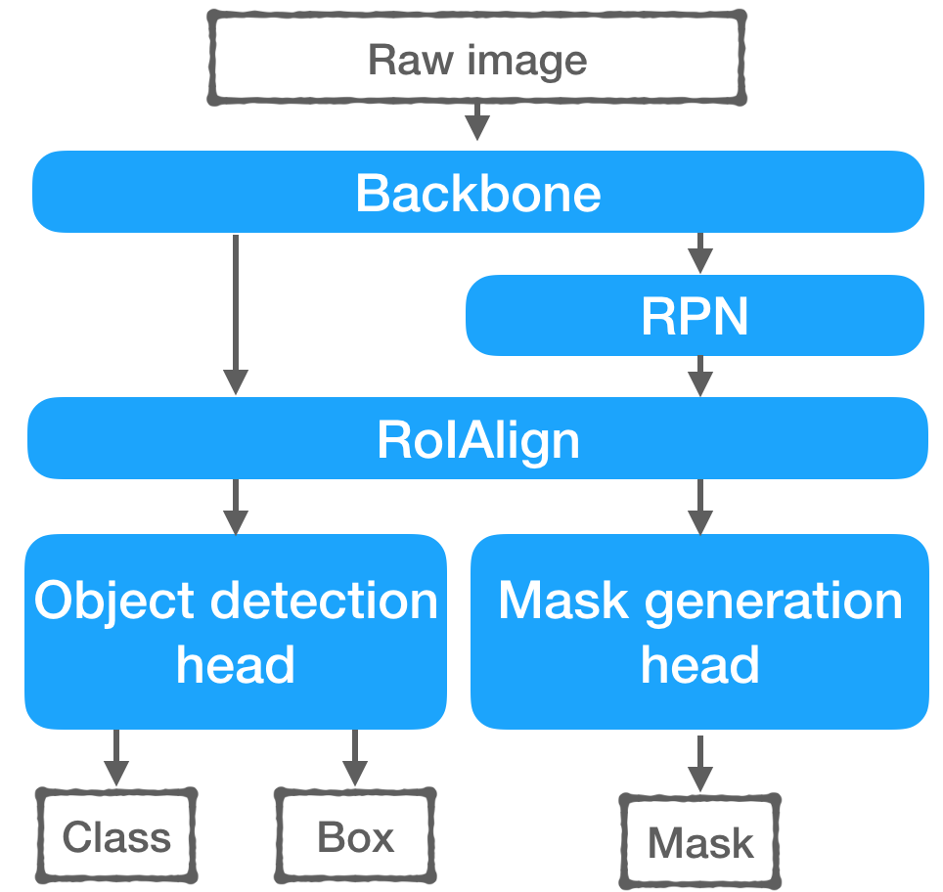
MASK RCNN
Instance Segmentation: Detecting objects and segmenting them with precise boundaries.
Difference from Object Detection: Includes pixel-wise segmentation.
Applications: Image editing, augmented reality, object tracking.
Extends Faster R-CNN to predict segmentation masks.
Object detection and segmentation simultaneously.
Components:
Backbone Network: Extracts feature maps (e.g., ResNet, FPN).
Region Proposal Network (RPN): Generates object proposals.
RoI Align: Improves feature extraction for each proposal.
Bounding Box Regression: Refines object localization.
Mask Prediction Branch: Produces object masks.

Slide 27
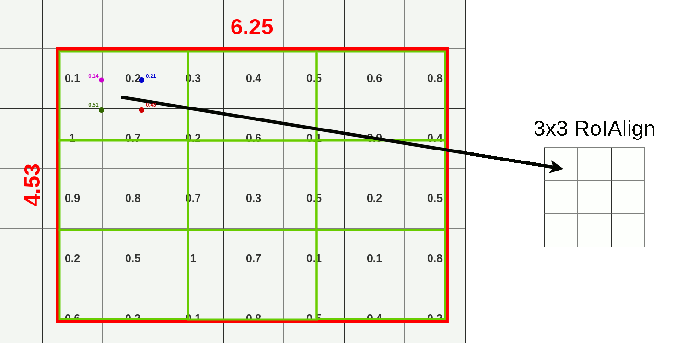
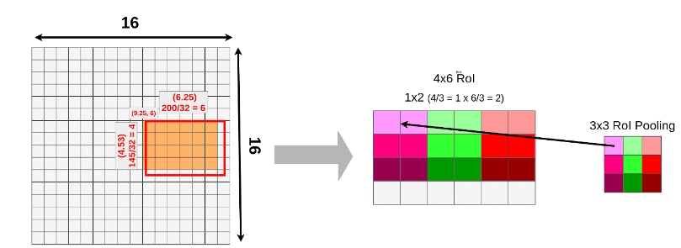
MASK RCNN
ROI Align:
Extracts features from proposed regions with better alignment.
It uses bilinearly interpolated points within the ROI, avoiding quantization errors compared to fixed number of grid points in ROI pooling.
Accurate feature extraction for small ROIs or deformed objects.

Slide 28
MASK RCNN
Applications:
Tumor detection, organ segmentation.
Pedestrian detection, lane segmentation.
Object tracking and interaction.
Limitations and Challenges:
Requires significant resources for training.
Model complexity can impact inference speed.
Needs accurate and extensive labeled data.
More Advanced Networks:
EfficientDet: Lightweight version of object detection networks.
PANet (Path Aggregation Network): Improved feature fusion. (next lecture)
YOLO (You Only Look Once): Real-time object detection advancements. (next lecture)

